Slide 1




Reforestation Monitoring and Evaluation
Partnership Initiative on Sustainable Land Management
Monday 8th July 2024

Slide 2
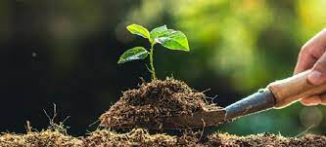
Session One
Introduction to Reforestation Monitoring and Evaluation Systems

Slide 3
Objectives
Provide an overview of reforestation goals and impacts.
Highlight the importance of Monitoring and Evaluation (M&E) in reforestation projects.

Slide 4
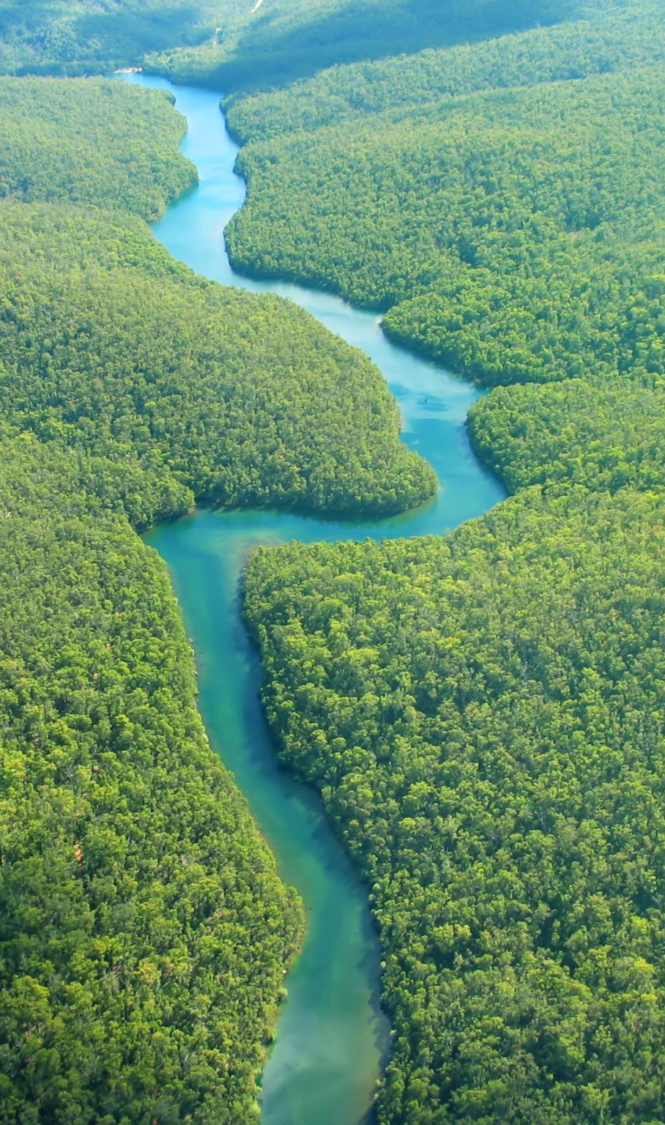
Summary of issue
Forest ecosystems are among Dominica’s most prized assets and is crucial for strengthening the islands resilience against climate change. Deforestation caused by agricultural and infrastructure expansion can exacerbate land degradation processes in many watersheds on the island. Extreme weather events such as hurricanes and storms are also likely to diminish resiliency of terrestrial ecosystems. The impacts of the two most recent weather events (TS Erika and Hurricane Maria) highlighted the need to address a range of environmental problems in a holistic way. Despite best efforts, Dominica remains particularly vulnerable to land degradation from deforestation and unsustainable agricultural practices because of its location in the hurricane belt in the Caribbean.

Slide 5

Reforestation
The process of planting trees on land that was previously forested but has been cleared or degraded. This can involve replanting native tree species to restore the original ecosystem or introducing new species to create a sustainable and productive forest.

Slide 6
Goals of Reforestation Projects
Restoring Ecosystems
Revitalize Degraded Lands: Reforestation helps to restore soil fertility and structure, reducing erosion and improving water retention.
Habitat Restoration: Reestablishing forests provides habitat for wildlife, promoting biodiversity and stabilizing ecosystems.

Slide 7
Goals of Reforestation Projects
Improving Biodiversity
Supporting Flora and Fauna: Reforested areas offer diverse habitats that support various plant and animal species.
Promoting Genetic Diversity: By planting a variety of native species, reforestation helps to maintain genetic diversity within ecosystems.

Slide 8
Goals of Reforestation Projects
Combating Climate Change
Carbon Sequestration: Trees absorb carbon dioxide from the atmosphere, storing carbon in their biomass and soils, which helps mitigate the effects of climate change.
Reducing Greenhouse Gas Emissions: Healthy forests act as carbon sinks, offsetting emissions from human activities.

Slide 9
Goals of Reforestation Projects
Supporting Local Communities
Economic Opportunities: Reforestation projects can create jobs in tree planting, maintenance, and related activities, boosting local economies.
Sustainable Livelihoods: Communities can benefit from the sustainable use of forest resources, such as timber, non-timber forest products, and ecotourism.

Slide 10
Goals of Reforestation Projects
Improving Water Quality & Availability
Watershed Protection: Forests play a crucial role in maintaining the health of watersheds, filtering pollutants, and regulating water flow..
Preventing Floods: By stabilizing soil and improving water infiltration, forests help to mitigate the impacts of extreme weather events.

Slide 11
Goals of Reforestation Projects
Enhancing Climate Resilience
Protecting against natural disasters: Forests act as natural barriers against landslides, windstorms, and other natural disasters.
Adapting to Climate Change: Reforestation can help landscapes and communities adapt to changing climate conditions by improving ecosystem services.

Slide 12
Reforestation Impacts
Environmental
Socio-Economic

Slide 13
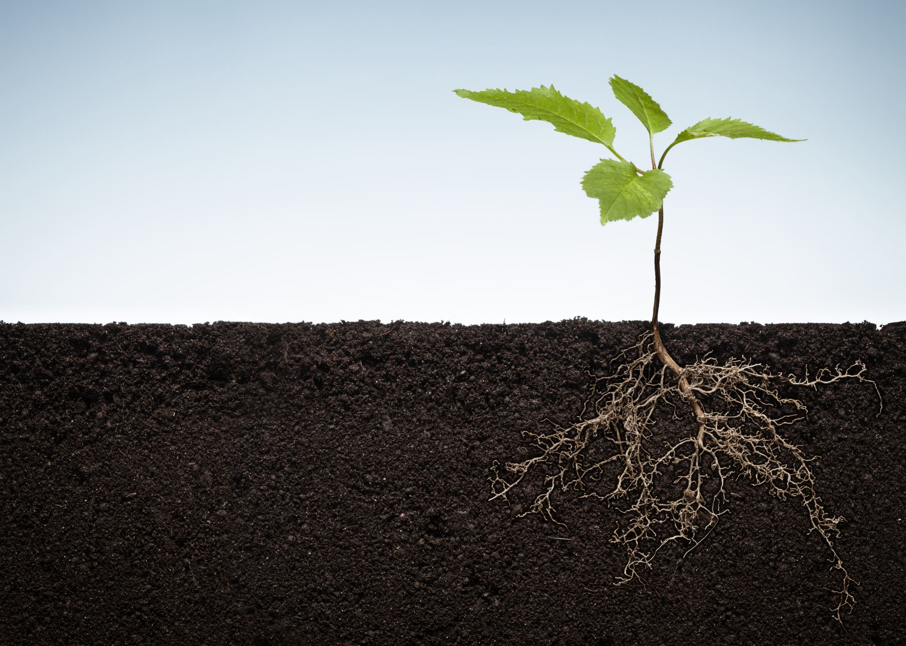
Environmental Impacts

Slide 14

Biodiversity Enhancement
Habitat Restoration: Reforestation creates and restores habitats for a variety of plant and
animal species, promoting biodiversity and enabling ecosystems to thrive.
Species Protection: By re-establishing forest areas, endangered and threatened species have a better chance of survival and recovery.
Soil Health Improvement
Erosion Control: Tree roots stabilize the soil, reducing erosion caused by wind and water. This is especially important in areas prone to landslides and flooding.
Soil Fertility: Leaf litter and organic matter from trees decompose and enrich the soil with nutrients, improving soil structure and fertility.

Slide 15
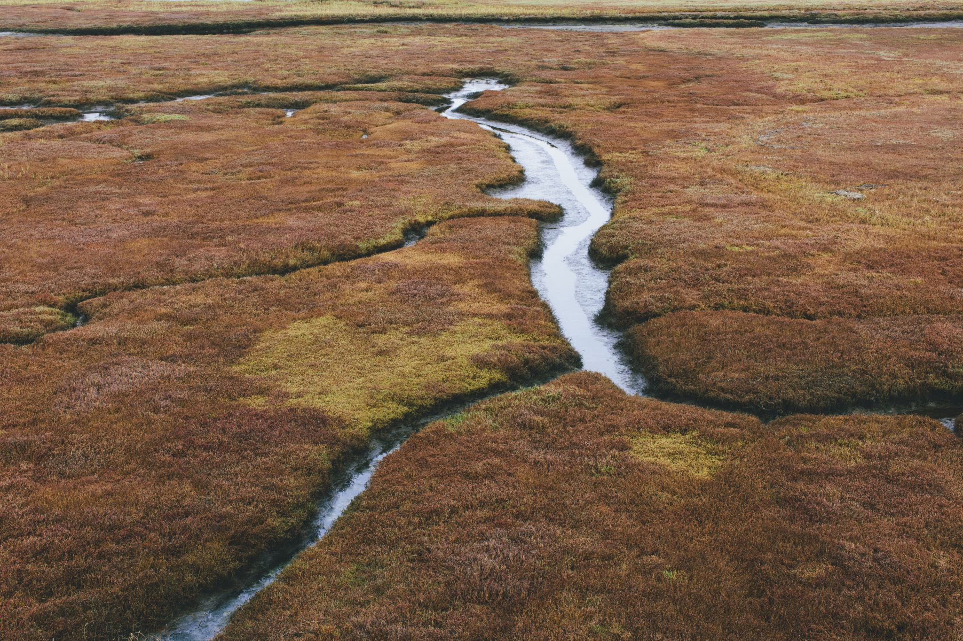
Water Cycle Regulation
Water Retention and Quality: Forests play a critical role in the water cycle by improving groundwater recharge and maintaining stream flow. They filter and purify water, reducing sediment and pollutant levels in water bodies.
Flood Mitigation: Forests reduce surface runoff and increase water infiltration into the soil, helping to mitigate
the severity and frequency of floods.
Climate Regulation
Carbon Sequestration: Trees absorb carbon dioxide from the atmosphere and store it as biomass, helping to mitigate the effects of climate change by reducing greenhouse gas concentrations.
Temperature Moderation: Forests can influence local and regional climates by providing shade, reducing surface temperatures, and contributing to the cooling effect through evapotranspiration.

Slide 16

Air Quality Improvement
Pollutant Absorption: Trees absorb pollutants such as nitrogen oxides, ammonia, sulphur dioxide, and particulate matter from the air, improving air quality.
Oxygen Production: Through the process of photosynthesis, trees release oxygen into the atmosphere,
which is essential for the survival of most living organisms.
Enhancement of Ecosystem Services
Pollination: Forests support a wide range of pollinators, including bees, birds, and bats, which are essential for the reproduction of many plants, including crops.
Nutrient Cycling: Trees contribute to the cycling of nutrients within an ecosystem, supporting plant growth and
maintaining ecological balance.

Slide 17
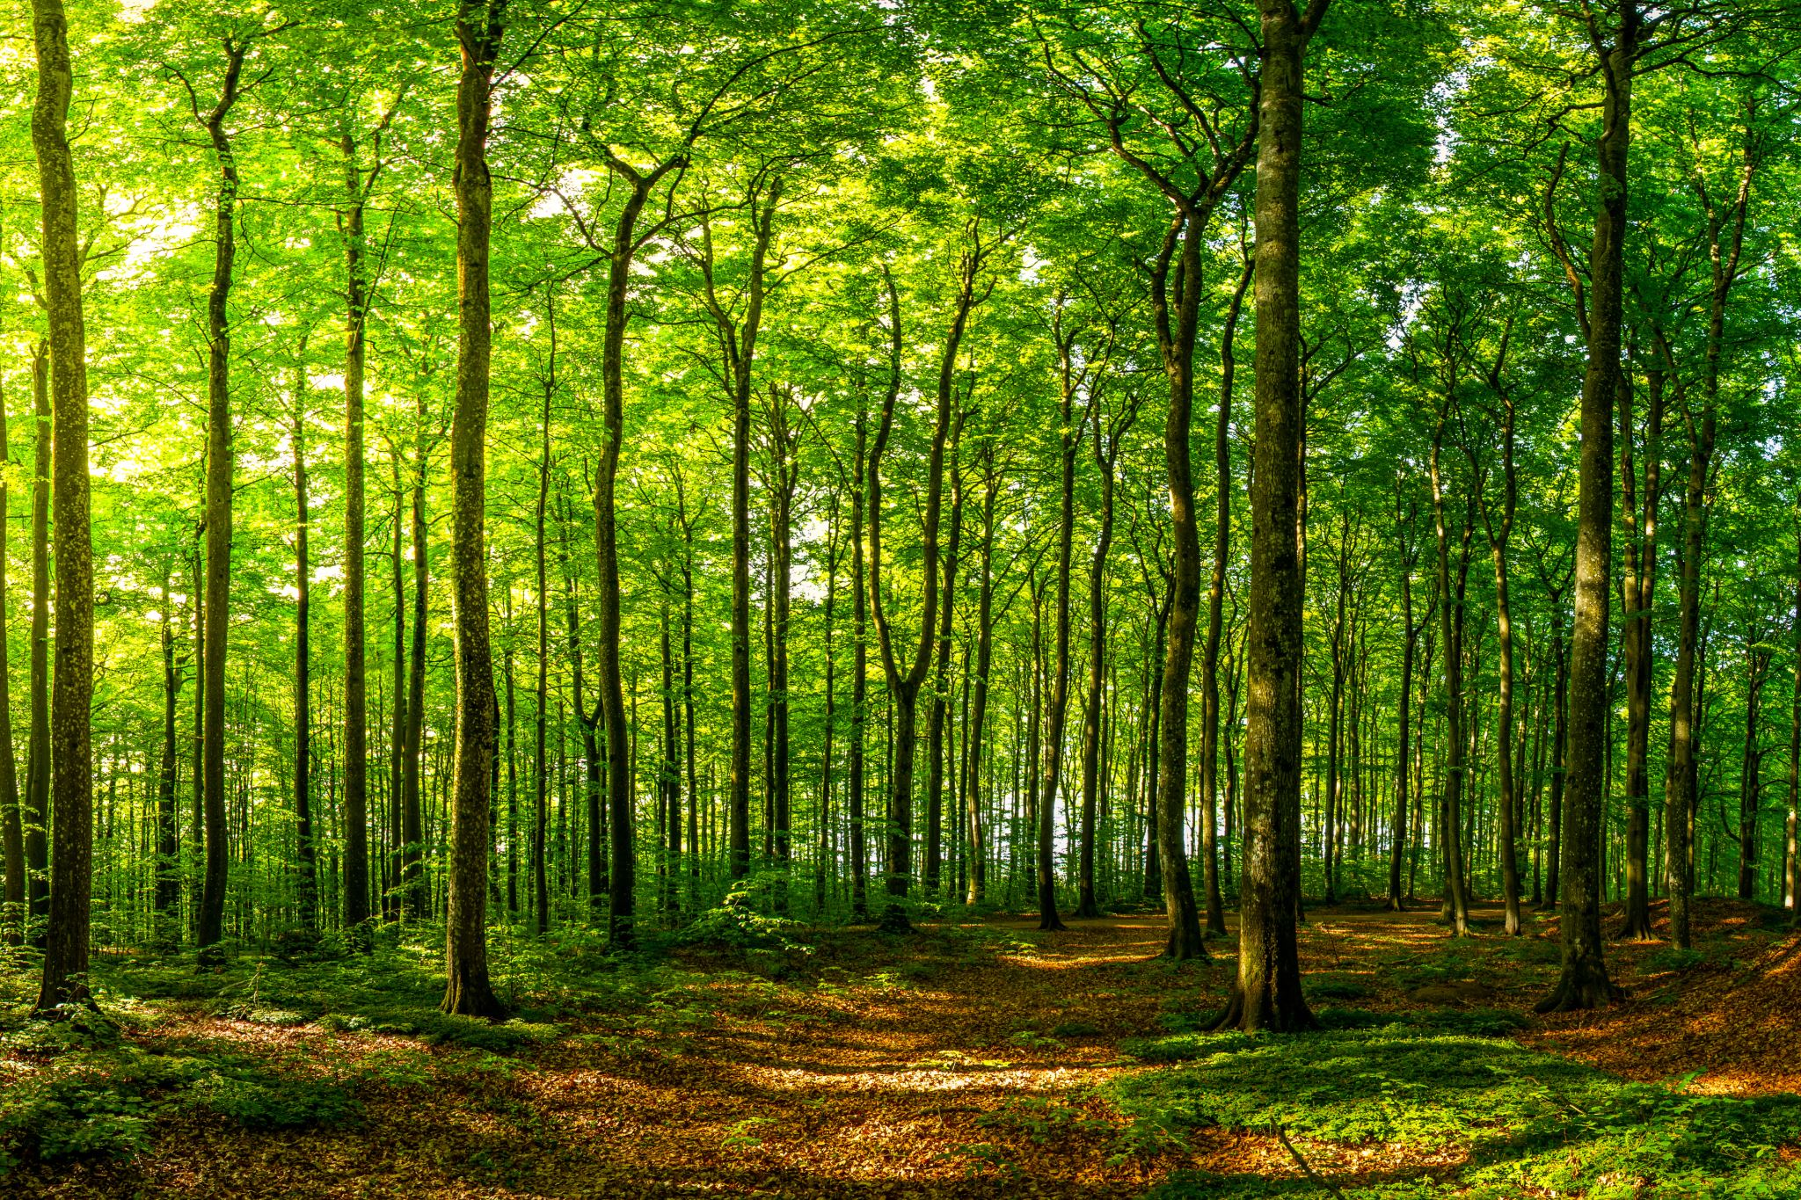
Aesthetic and Recreational Value
Scenic Beauty: Reforested areas enhance the natural beauty of landscapes, providing aesthetic value and improving the quality of life for local communities.
Recreational Opportunities: Forests offer recreational spaces for activities such as hiking, bird-watching, and camping, contributing to physical and mental well-being.

Slide 18
Success in reforestation
Case Studies-Examining success in reforestation

Slide 19

Indonesian ‘madman’ turns barren hills green by planting 11,000 trees

Slide 21

Importance of Monitoring and Evaluation (M&E) in Reforestation Projects

Slide 22

Rationale for monitoring and evaluation
Implementing a monitoring and evaluation framework after reforestation activities is essential for assessing success, identifying challenges, facilitating learning and adaptation, promoting accountability and transparency, optimizing resource allocation, demonstrating impact, and supporting continuous improvement. By systematically monitoring and evaluating reforestation efforts, stakeholders can enhance their effectiveness, sustainability, and long-term impact on forest ecosystems and communities. Implementing a monitoring and evaluation (M&E) framework after reforestation activities is crucial for several reasons.

Slide 23

Monitoring
Monitoring is the systematic and continuous process of collecting, analyzing, and using information to track the progress of a project or program against its planned objectives and activities. It involves the regular observation and recording of activities taking place in a project or program. Its main purpose is to ensure that project implementation stays on track, to detect any issues early, and to provide ongoing feedback to stakeholders to make informed decisions. Monitoring focuses on the inputs, activities, outputs, and sometimes initial outcomes.
Key Aspects of Monitoring:
Continuous Process: Ongoing and regular.
Data Collection: Gathering information on project activities and outputs.
Progress Tracking: Comparing actual progress with planned targets.
Early Warning: Identifying problems or deviations from the plan early.
Feedback Mechanism: Providing timely information to stakeholders for decision-making.

Slide 24

Evaluation
Evaluation is the systematic and objective assessment of a completed project, program, or policy, including its design, implementation, and results. The purpose of evaluation is to determine the relevance, efficiency, effectiveness, impact, and sustainability of the project or program. Evaluation is typically carried out at specific points in time, such as mid-term, end of a project, or after project completion. It provides a deeper analysis of the extent to which the objectives were achieved and the reasons for success or failure.
Key Aspects of Evaluation:
Systematic Assessment: Structured and objective analysis.
Objective Measurement: Using criteria like relevance, efficiency, effectiveness, impact, and sustainability.
Periodic: Conducted at specific intervals or project milestones.
In-depth Analysis: Examining the underlying reasons for outcomes.
Lessons Learned: Identifying best practices and lessons for future projects.

Slide 25

Combined Role of Monitoring and Evaluation
Monitoring and Evaluation (M&E) together form an essential part of project and program management. While monitoring provides ongoing feedback and identifies potential issues early, evaluation offers a comprehensive analysis of the project's overall success and areas for improvement. M&E systems are crucial for accountability, learning, and continuous improvement in project management. They ensure that resources are used effectively, goals are met, and positive impacts are achieved and sustained.

Slide 26
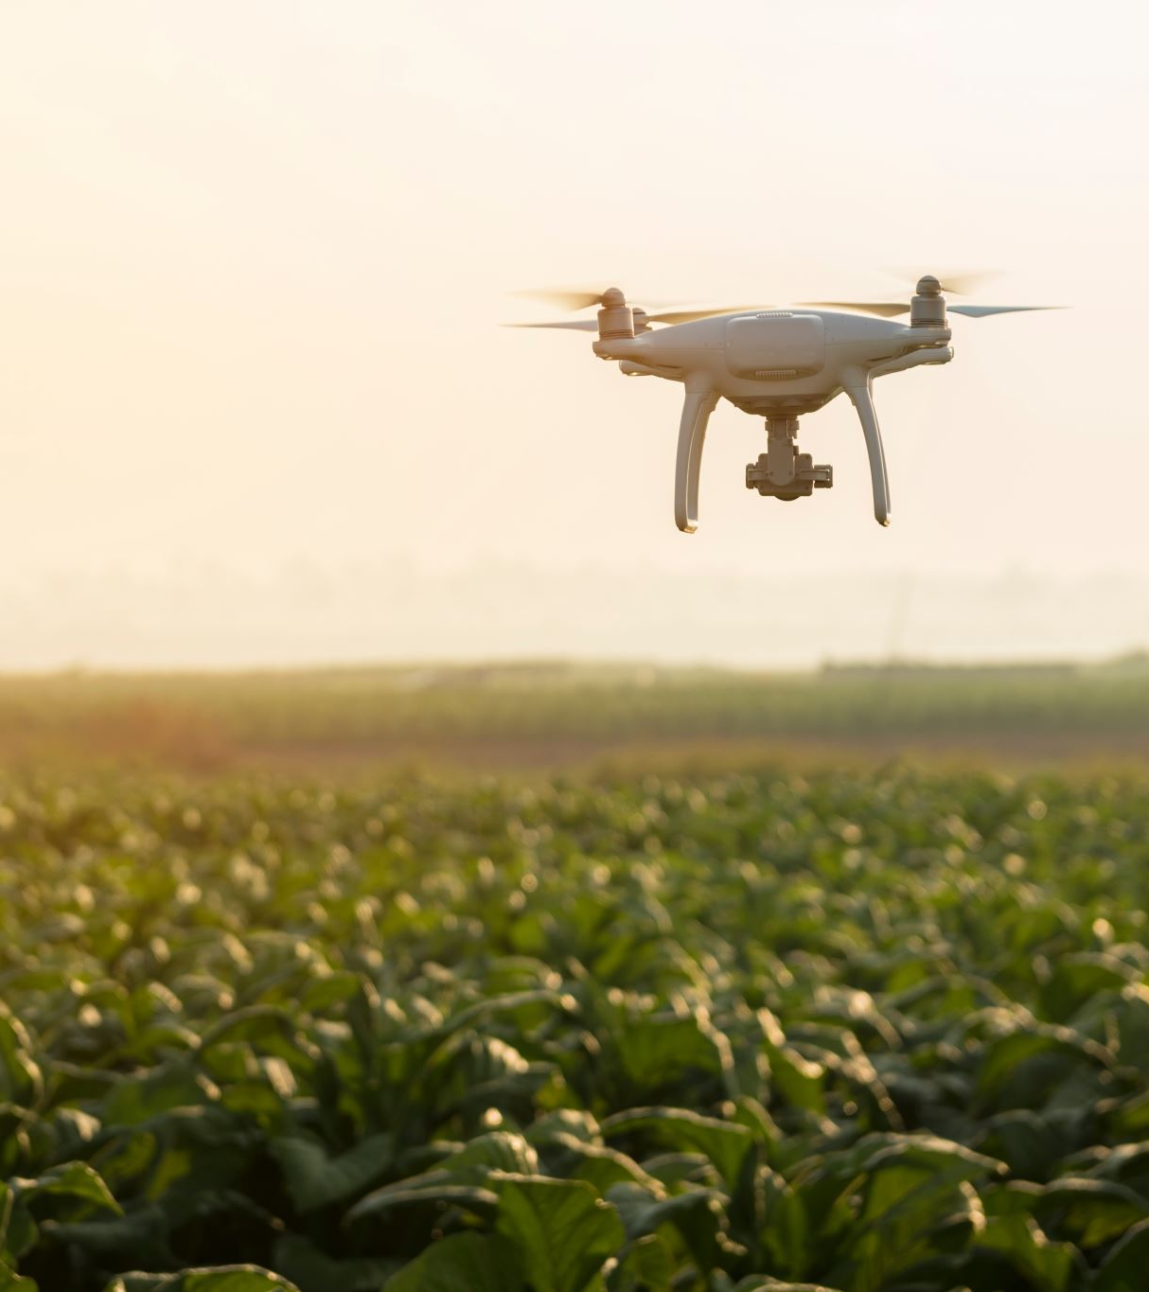
Tracking Progress and Ensuring Goals are Met
Monitoring Progress: M&E systems help track the implementation of reforestation activities in real-time, ensuring that planting schedules and growth targets are adhered to.
Example: Regular site visits, satellite imagery, and drone surveillance.
Meeting Goals: By comparing actual outcomes with planned objectives, M&E ensures that the project stays on track and achieves its intended impact.
Example: Measuring tree survival rates, growth metrics, and biodiversity indices.
Data-Driven Decisions: Continuous data collection allows for timely adjustments to strategies and interventions, maximizing project success.

Slide 27
Identifying Challenges and Areas for Improvement
Early Detection of Issues: M&E systems identify challenges such as pest infestations, poor soil quality, or adverse weather conditions early on.
Example: Weekly reports from field workers and automated alerts from environmental sensors.
Continuous Improvement: Feedback from M&E activities informs the refinement of techniques and methodologies.
Example: Switching to more resilient tree species or adopting better planting techniques based on M&E findings.
Adaptive Management: Enables the project team to respond adaptively to unforeseen circumstances, ensuring project resilience and sustainability.
Example: Adjusting water management practices during drought periods based on M&E data.

Slide 28
Ensuring Accountability and Transparency
Accountability: M&E ensures that all stakeholders, including funders, local communities, and governmental bodies, are kept informed about the project's progress and outcomes.
Example: Regularly published M&E reports and stakeholder meetings.
Transparency: Open sharing of M&E findings promotes trust and collaboration among stakeholders.
Example: Online dashboards and public access to M&E data.
Resource Management: Ensures that resources (financial, human, and natural) are used efficiently and effectively.
Example: Tracking budget expenditures against project milestones.

Slide 29
Summary: M&E plays a pivotal role in reforestation by tracking progress, identifying challenges, and ensuring accountability and transparency.
Impact: Effective M&E leads to more successful reforestation projects, contributing to environmental sustainability and community wellbeing.
Call to Action: Encourage stakeholders to invest in robust M&E systems to enhance the effectiveness of reforestation efforts.

Slide 30
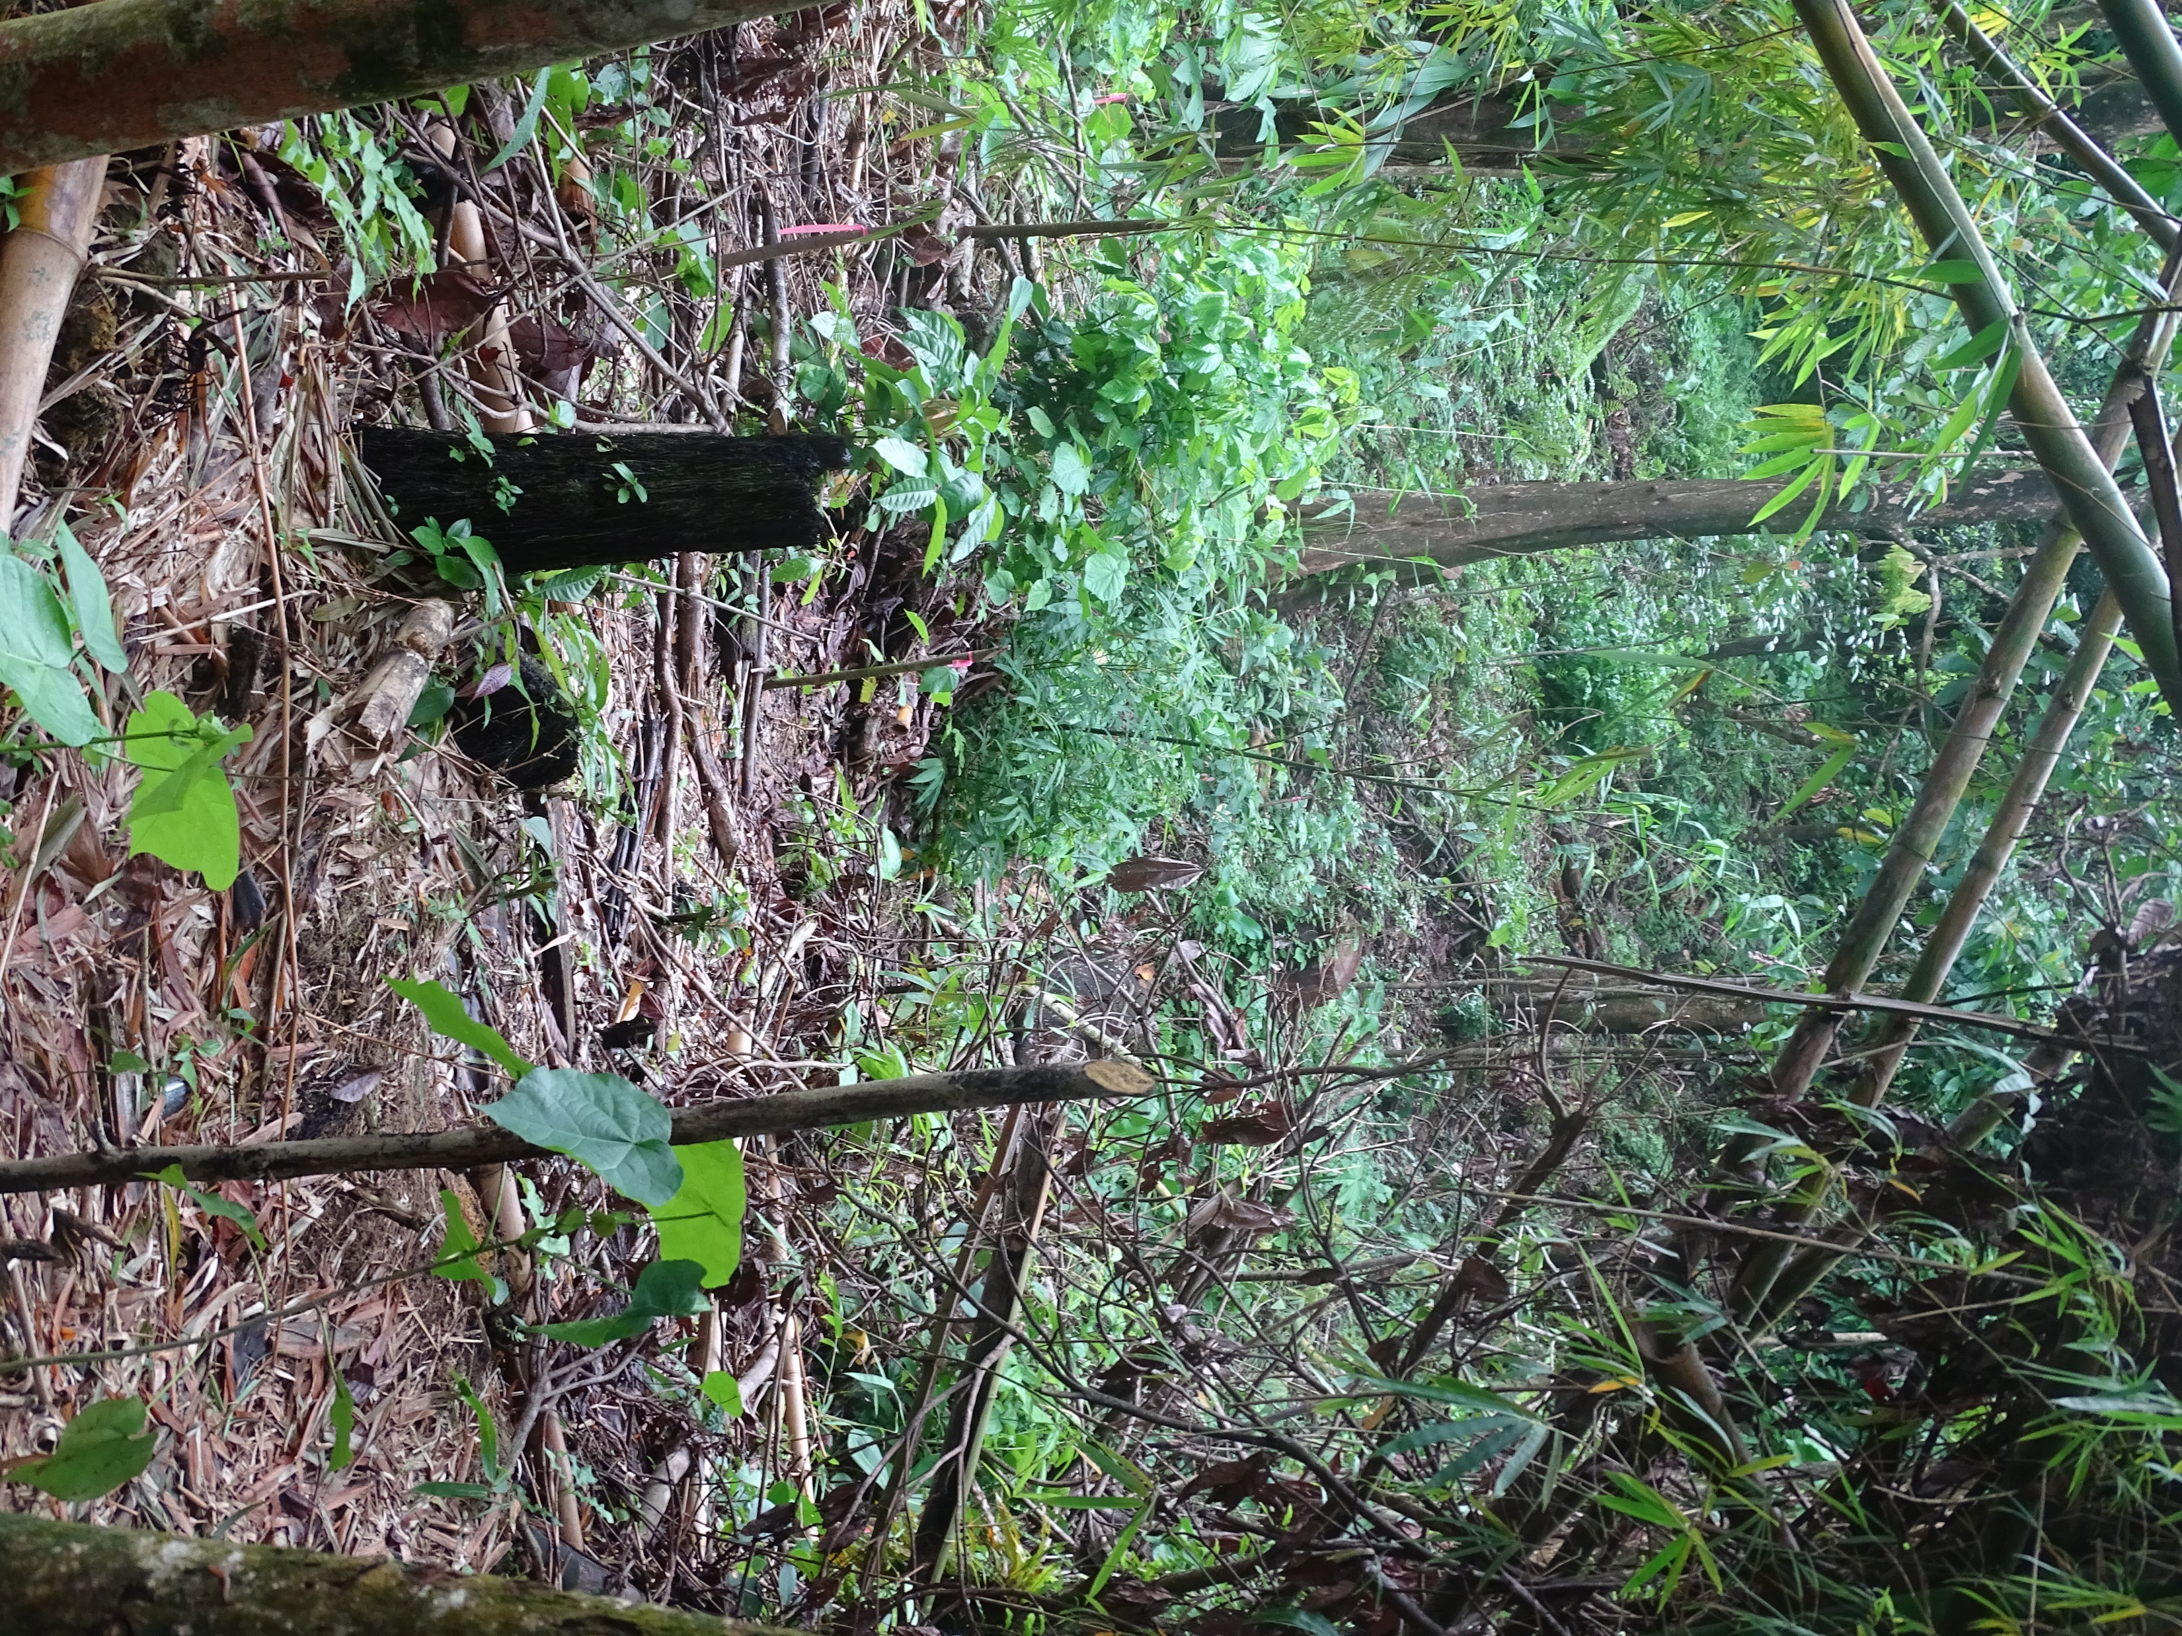
COMPONENTS
OF
THE FORESTRY & WILDLIFE DIVISON
MONITORING AND EVALUATION SYSTEM

Slide 31
Key Components of the Reforestation Monitoring and Evaluation System
Regular Monitoring (Indicators and Metrics)
Data Collection Methods
Data Management System
Reporting and Communication

Slide 32
Regular Monitoring (Indicators and Metrics)
Key performance indicators (KPI)
Monitoring reforestation efforts requires tracking various key performance indicators (KPIs) to assess progress and effectiveness.
Key Performance Indicators (KPIs) are a set of critical metrics that summarize performance. They create a quantifiable baseline to help focus attention and improve decision-making.

Slide 33
Biophysical/Environmental Key Performance Indicators
These biophysical KPI’s provide valuable insights into the ecological performance and sustainability of reforestation plots, guiding management decisions and adaptive strategies to enhance their long-term success.
Tree Survival Rate: This KPI measures the percentage of planted trees that have survived after a specified period, typically one year or more. It indicates the success of tree establishment and can be used to assess the effectiveness of planting techniques and site preparation.
Tree Growth and Diameter at Breast Height (DBH): Monitoring the growth of individual trees and measuring their DBH provides insights into the development and health of the forest stand. It helps assess whether trees are growing at expected rates and if they are reaching maturity.
Species Diversity and Composition: Assessing the diversity and composition of tree species within reforestation plots is crucial for promoting biodiversity and ecosystem resilience. Monitoring changes in species richness and evenness over time helps evaluate the effectiveness of reforestation efforts in restoring native ecosystems.

Slide 34
d) Soil Health Indicators: Soil health is fundamental for supporting tree growth and ecosystem functioning. Key soil health indicators include soil organic matter content, nutrient levels (e.g., nitrogen, phosphorus, potassium), pH, soil compaction, and soil moisture. Monitoring these indicators helps ensure that reforestation activities are promoting soil fertility and resilience.
e) Water Quality and Hydrological Processes: Reforestation can influence water quality and hydrological processes, such as runoff, infiltration, and groundwater recharge. Monitoring parameters such as sedimentation, nutrient runoff, and stream flow helps assess the impact of reforestation on water resources and ecosystem services.
f) Wildlife Habitat and Corridor Connectivity: Reforestation projects often aim to enhance habitat quality and connectivity for wildlife species. Monitoring indicators such as the presence of wildlife species, nesting sites, and movement patterns helps evaluate the effectiveness of reforestation in supporting biodiversity conservation.

Slide 35
g) Carbon Sequestration and Storage: Reforestation plays a vital role in sequestering carbon dioxide from the atmosphere and storing it in tree biomass and soil organic matter. Monitoring changes in aboveground and belowground carbon stocks helps quantify the carbon sequestration potential of reforestation plots and assess their contribution to climate change mitigation.
h) Erosion Control and Slope Stability: Reforestation can help mitigate soil erosion and stabilize slopes, particularly in degraded or vulnerable landscapes. Monitoring indicators such as erosion rates, sedimentation, and changes in slope stability helps evaluate the effectiveness of reforestation in soil conservation and land rehabilitation.
Biodiversity: Assessing the diversity and abundance of other plant species, as well as wildlife, within reforestation plots, provides insights into the overall ecological value of the restored forest ecosystem. This KPI can include surveys of understory vegetation, insects, birds, and other fauna.
j) Invasive Species and Pest Infestations: Monitoring for invasive plant species and pest infestations helps prevent their establishment and spread within reforestation plots, which can negatively impact tree growth and ecosystem health.

Slide 36
Key Performance Indicator (KPI) | Objective | Suggested evaluation tools/indicators | Measurement frequency | Responsibility | Reporting frequency
Tree Survival Rate | -Measure tree survival rate | -Number of surviving trees | Quarterly | FWD Staff | Quarterly
Tree Growth | -Measure DBH (Diameter Breast Height) -Measure tree height | -Growth Increment | Quarterly | FWD Staff | Quarterly
Soil Health | -Measure soil organic matter content, nutrient levels (e.g., nitrogen, phosphorus, potassium), pH, soil compaction, and soil moisture | -Success and diversity of cover crops -PH levels -Improved soil texture and structure, -Water infiltration rate, holding capacity -Increased presence of soil organisms | Quarterly | FWD Staff | Quarterly
Water quality | -Measure of water quality indicators such as turbidity, temperature and nutrient levels. | -Low Turbidity -Optimum PH Levels -Temperature -Nitrate and Phosphate level -Presence of aquatic organisms | Semi-annually | FWD Staff | Semi-Annually

Slide 37
Key Performance Indicator (KPI) | Objective | Suggested evaluation tools/indicators | Measurement frequency | Responsibility | Reporting frequency
Wildlife Habitat and Corridor Connectivity | -Evaluate whether the reforested area provides the necessary resources for wildlife. -Evaluate wildlife movement. | -Species Presence -Water availability -Evidence of wildlife -Availability of food sources | Semi-annually | FWD Staff | Semi-annually
Erosion Control and Slope Stability | -Monitoring of slope stability and erosion -Record of incidence of land slippage -Monitor sedimentation in nearby streams | -Decrease in soil loss -Reduced surface runoff -Improvements in land stability -Reduced occurrence of land slippage -Reduction in sediment in streams | Quarterly | FWD Staff | Quarterly
Biodiversity | -Identify the species present (flora and fauna) and their abundance. | -Count of the number of different species -Presence or increase in threatened or endangered species -Presence or increase in endemic species | Semi-annually | FWD | Semi-annually
Invasive Species and Pest Infestations | -Monitor invasive species and pest infestations | -Unusual plant growth patterns -Visible damage in trees -Decrease in wildlife population -Presence of pests -Sudden tree decline | Monthly | FWD | Monthly

Slide 38
Key Performance Indicator (KPI) | Objective | Suggested evaluation tools/indicators | Measurement frequency | Responsibility | Reporting frequency
Diseases |  | -Leaf discoloration and blight -Defoliation -Sudden tree death -Root rot -Wilting | Monthly | FWD | Monthly

Slide 39
ACTIVITY
Review of Indicators

Slide 40

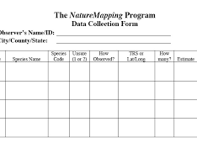

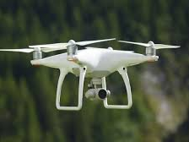
DATA COLLECTION
METHODS
&
TOOLS

Slide 41
Data Collection Methods/Tools
Digitized field Observation Forms, data sheets and registers: Paper-based forms, standardized data sheets and registers used to record planting activities, tree survival rates, growth measurements, and any signs of pests, diseases, tree species, planting density, tree measurements (height, diameter), maintenance activities, and other relevant parameters will be digitized.
Mobile Data Collection: Mobile data collection apps enable real-time data collection, entry, and synchronization using smartphones or tablets, facilitating efficient data capture in the field and reducing manual data entry errors.
Photographic Documentation: Photographs or videos taken at regular intervals provide visual documentation of reforestation activities, changes in vegetation cover, and tree growth over time.

Slide 42
Vegetation Sampling Tools: Quadrats, transects, and plot sampling techniques are used to systematically sample vegetation within reforestation sites, measure species diversity, vegetation cover, and assess ecological indicators such as plant community composition.
Remote Sensing Technology: Remote Sensing Technology plays a critical role in monitoring reforestation projects, offering a scalable and efficient means to track vegetation changes, forest health, and the progress of reforestation efforts over time.
Soil Sampling Kits: Soil sampling kits can be used to collect soil samples from reforestation sites for analysis of soil fertility, pH levels, nutrient content, and other soil properties that can impact tree growth and ecosystem health.

Slide 43

Data Analysis and Interpretation

Slide 44

Data Analysis and Interpretation
Data analysis and interpretation are foundational to the success of reforestation monitoring projects, providing the evidence base for evaluating performance, guiding future actions, and ensuring the long-term sustainability and effectiveness of reforestation efforts.

Slide 45
Quantum GIS
QGIS (Quantum GIS) is a powerful, open-source Geographic Information System (GIS) that is widely used for analyzing spatial data, including data related to reforestation projects. It offers a variety of tools and functionalities that can help in the planning, monitoring, and evaluation of reforestation efforts.
Microsoft Excel
Microsoft Excel is a versatile tool that can be effectively used for analyzing reforestation data. With its comprehensive set of features for data analysis, visualization, and management, Excel can help researchers, environmental scientists, and project managers to track, analyze, and report on the progress of reforestation projects.
Microsoft Access
Microsoft Access can be a valuable tool for managing reforestation data, offering flexibility in database design, data analysis, and reporting.

Slide 46

Reporting and Communication

Slide 47

Reporting and communication are critical components of reforestation monitoring, as they ensure transparency, foster stakeholder engagement, and facilitate adaptive management. Effective reporting and communication strategies can help translate complex data into actionable insights and share successes and challenges with a broader audience.

Slide 48
Here are key elements and strategies for enhancing reporting and communication in reforestation monitoring:
Develop Clear and Concise Reports
Utilize Digital Platforms
Implement Interactive GIS Maps
Facilitate meetings and workshops
Publish Scientific Papers and Technical Bulletins
Annual and Mid-term Reviews

